Slide 1
“The One About Microsoft Advanced Threat Analytics”
Russell Butturini (@tcstoolhax0r)
Bsides Nashville 2018

Slide 2
WHOIS Record
-Security architect at a Top 20 CPA firm (Who I’m not representing here today in any way, shape or form)
-15 years in IT and 10 full time doing security stuff (pen testing, infrastructure, cloud stuff)
-Not a Microsoft fanboy
-Original creator of NoSQLMap (@codingo_ maintains it now, he’s awesome, go help him out!)
Notes:
Michael Skelton is the maintainer of NoSQLMap now, great dude, knows what he’s doing!

Slide 3
Why give this talk?
-There aren’t enough “kick the tires” talks at security cons.
-IMO not enough people know about ATA; it’s a great tool, but there’s a lot of ways to screw it up, and the documentation provided by Microsoft is cluttered.
-All the non-vendor talks and blogs out there on ATA were either about bypassing it, or running it in a lab, but not on running it in production.
DISCLAIMER: I don’t work for Microsoft. These are my experiences. I may get stuff wrong. Your milage may vary.

Slide 4
Agenda
-What is Advanced Threat Analytics? (And more importantly, what ATA isn’t!)
-Architecture, setup, and security considerations
-”Find all the things”
-Maintenance and troubleshooting
-Questions/comments/profanity

Slide 5
What is Advanced Threat Analytics?
-Monitoring solution based on Aorato acquisition.
-Included with Enterprise CAL suite, Enterprise Mobility Suite + Security, and Enterprise Cloud Suite licenses.
-Uses behavioral analytics, network traffic, and event logs to detect advanced threats in the network (e.g. pass-the-hash, Kerberos golden ticket abuse, AD recon attacks, password spraying)
-Also can find authentication configuration issues (cleartext LDAP, broken trusts, remote process starts ,etc.)
-Designed with “alert fatigue” in mind

Slide 6
What ATA is NOT
-A replacement for your SIEM
-A solution that will check many compliance requirement boxes
- A robust reporting tool

Slide 7
ATA Eye Chart

Slide 8
ATA Architecture
-Two components: Centers and Gateways
-Centers do all the alerting, configuration, management, data aggregation.
-Gateways receive traffic and event log events for analysis and forwarding to centers.

Slide 9
ATA Center
-The “brains” and user interface of ATA
-Uses MongoDB to store traffic data and event logs forwarded from domain controllers (more on this later)
-Needs lots of resources! (2 procs, 32 GB RAM minimum-More is better)
-Can forward generated alerts to SIEM, email, or other external sources.

Slide 10
ATA Center Installation

Slide 11
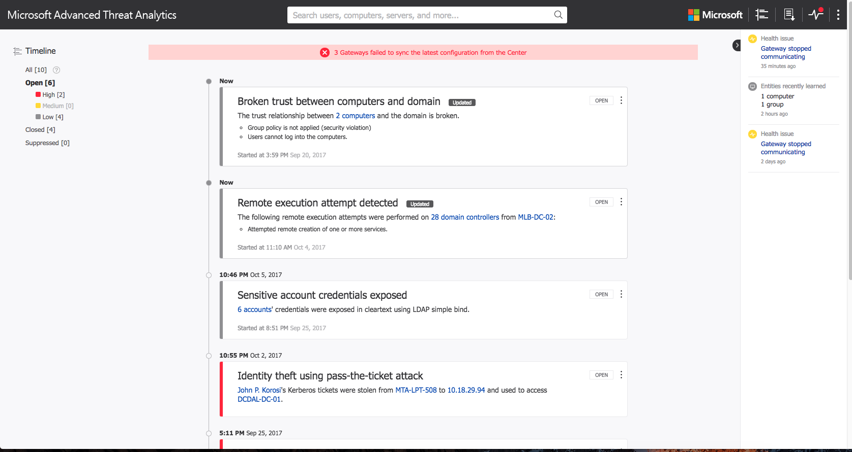

Slide 12
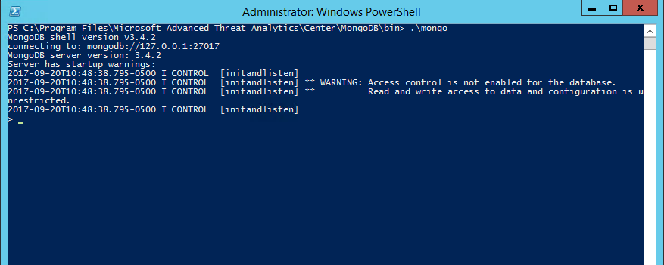
ATA Center
NIST 800-53 AU-9 – Protection of Audit Information The information system protects audit information and audit tools from unauthorized access, modification, and deletion.

Slide 13
Managing Access
-ATA Administrators: Full Access to everything
-ATA Users: View/update suspect activity, close incidents, export data
-ATA Viewers: View incidents

Slide 14
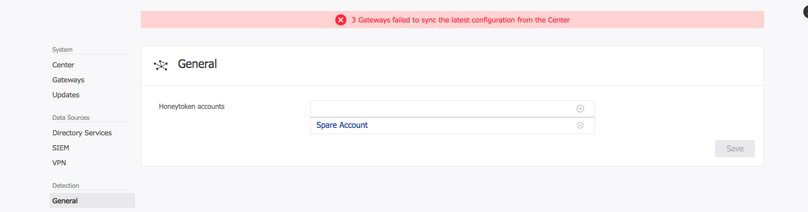
Honeytoken Accounts
-Allows specification of bogus AD accounts that should never be used.
-Any activity with this account triggers a high severity alert.

Slide 15
ATA Gateways
-Come in two flavors: Gateways and lightweight gateways
-Lightweight gateways run directly on DCs and monitor resource usage to prevent performance issues.
-Gateways run on dedicated servers and need port spans/mirroring + Windows Event Forwarding.
-Ingest domain controller network traffic and event logs for analysis and forwarding to the ATA center.

Slide 16
Lightweight Gateway Notes
-MS says lightweight gateways won’t work right on VMWare. Mine work fine.
-As of v1.8, lightweight gateways can read event logs directly from the domain controller, no WEF required.
-Throughput for lightweight gateways is much lower than dedicated gateways. Good for branch offices, use dedicated gateways in data center.

Slide 17
Gateway Installation
-Uses a customized package in a ZIP file downloaded from the ATA center.
-Contains a JSON file with configuration settings.
-Can be scripted and installed silently; see https://docs.microsoft.com/en-us/advanced-threat-analytics/ata-silent-installation
-The center can be installed silently too, but I don’t recommend it!

Slide 18
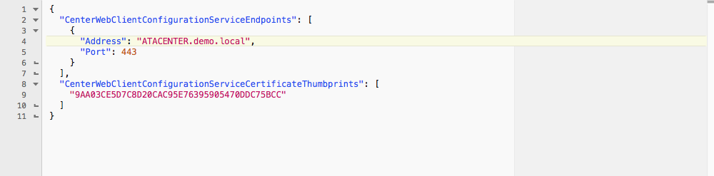
Gateway Installation

Slide 19
Gateway Installation
-A backup of the gateway configuration data is made to C:\Program Files\Microsoft Advanced Threat Analytics\Center\Backup once an hour.
-10 backups are retained; this file is CRITICAL if you have to restore the Center.

Slide 23
Find all the things!
-ATA alerting is great and well tuned out of the box.
-Behavioral analysis needs about 30 days to work properly.
-IT admin activities (like workstation patching) seem to throw it off; balance between tuning the accounts and ignoring the alert during maintenance windows.
-Users/machines moving in a way DNS can’t be resolved (like VPN) can cause false positives.

Slide 24
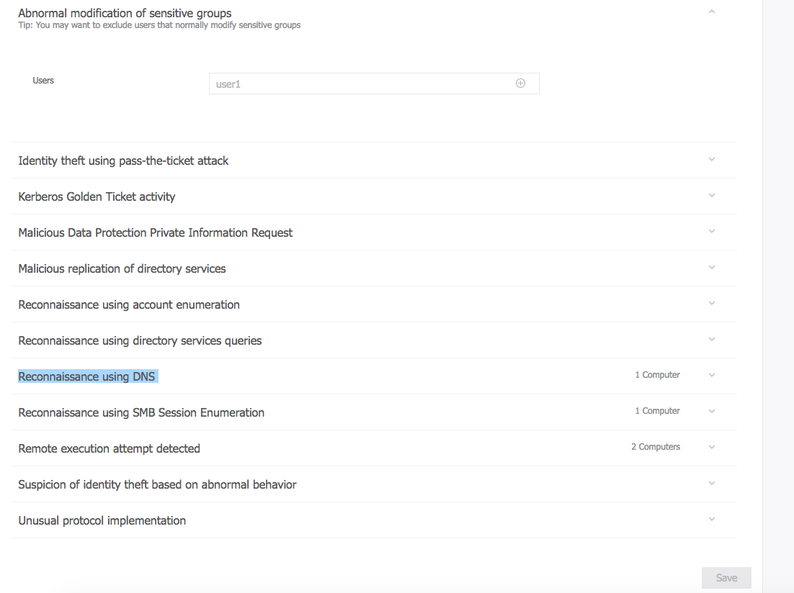

Slide 25
For the truly hardcore threat hunters…
-The ATA MongoDB instance can be queried directly (but remember the security deficiencies we talked about before…)
-Example: You want to know about the NTLM activities John Doe performed on 10/1/2017:
-db.UniqueEntity.find({Name: "John Doe"})
-Note the _id key value pair (123bdd24-b269-h6e1-9c72-7737as875351)
-db.Ntlms_<closest date>.find({SourceAccountId: "123bdd24-b269-h6e1-9c72-7737as875351"})
Reference: https://docs.microsoft.com/en-us/advanced-threat-analytics/troubleshooting-ata-using-ata-database

Slide 26
Getting Help
-ATA support forum: https://social.technet.microsoft.com/Forums/en-US/home?forum=mata
-Constantly monitored by ATA support staff in Israel. Quick support, and will help over email if problems get too complex to resolve on the forum.

Slide 27
What if I don’t own/like this???
-A similar free alternative: https://www.blackhillsinfosec.com/endpoint-monitoring-shoestring-budget-webcast-write/
-Uses Elasticsearch, Logstash, Kibana, and Windows Event Forwarding to gather logs and find anomalous events.
-Not as out of the box ready, but can obtain similar results.

Slide 28
That’s it!
-Slides will be available here: https://github.com/tcstool/ata
-Feel free to send questions to me @tcstoolhax0r
-Thanks to Bsides Nashville for letting me speak!

